Slide 1




STUDENT NAME: HARISH VISHWA
REGISTER NO: 422200015
DEPARTMENT: B. COM[ISM]
COLLEGE:S.I.V.E.T COLLEGE

Slide 2

PROJECT TITLE
CUSTOMER SEGMANTATION IN EXCEL

Slide 3

AGENDA
Problem Statement
Project Overview
End Users
Our Solution and Proposition
Dataset Description
Modelling Approach
Results and Discussion
Conclusion
3/21/2024 Annual Review

Slide 4

PROBLEM STATEMENT
The problem statement of customer segmentation is finding the dominant patterns of customer movements between different segments over time. The problem statement of customer segmentation is the identification of homogeneous segments of customers based on their similar characteristics and activities.

Slide 5

PROJECT OVERVIEW
Customer segmentation is the process of dividing a company's customers into groups based on common characteristics so companies can market to each group effectively and appropriately. In business-to-business marketing, a company might segment customers based on a wide range of factors, including: Industry

Slide 6

WHO ARE THE END USERS?
A customer segment is a group of consumers who share similar characteristics and needs. By identifying and understanding your different customer segments, businesses can tailor their products, services, and marketing efforts to better meet the specific needs of each segment.

Slide 7
OUR SOLUTION AND ITS VALUE PROPOSITION
Before you segment your market, you need to have a clear and compelling value proposition that defines what makes your product or service different and better than your competitors. Your value proposition should answer three questions: what problem do you solve, how do you solve it, and why should customers choose you.

Slide 8
Dataset Description
A company that sells some of the product, and you want to know how well does the selling performance of the product. You have the data that can we analyze, but what kind of analysis that we can do? Well, we can segment customers based on their buying behavior on the market.

Slide 9
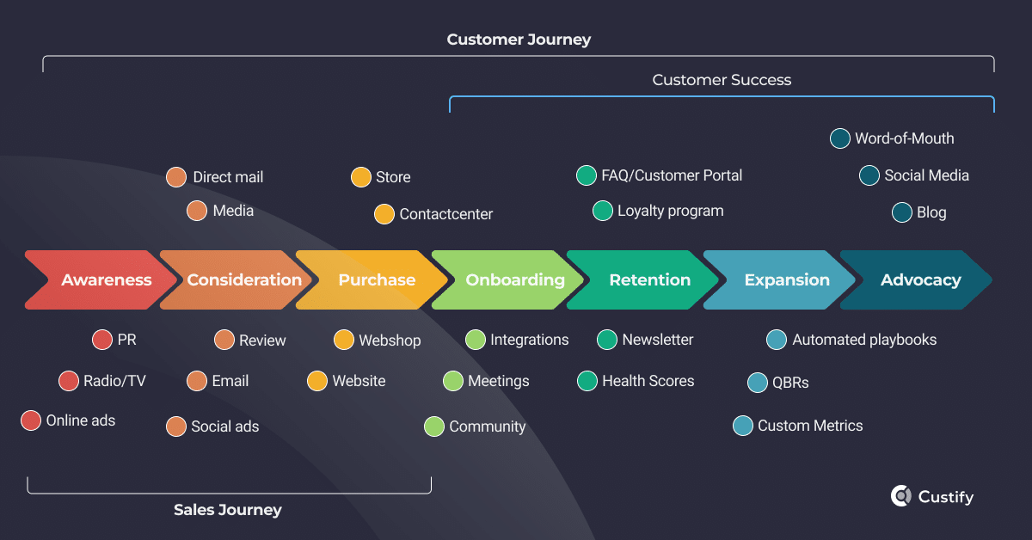
THE "WOW" IN OUR SOLUTION
3/21/2024 Annual Review
9

Slide 10
MODELLING
A customer segmentation model is a specific way of dividing your audience into groups based on shared characteristics. For example, demographic segmentation would involve creating audience sub-groups based on their demographic similarities, like age, gender, location, job title, and income.
10

Slide 11
RESULTS
Enhanced customer relationship and brand loyalty: Customer segmentation shows you precisely what each customer seeks so that you can align your marketing messages and know the exact channel to use for communicating with them. It reveals customers' interests, spending habits, budgets and more to you.
11

Slide 12
conclusion
Customer segmentation gives businesses the power to craft relevant marketing campaigns aligning with every group of customers. It results in improved conversion rates, increased customer engagement, and higher response rates

